Slide 1

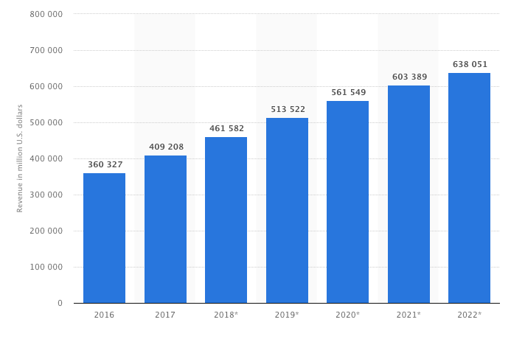
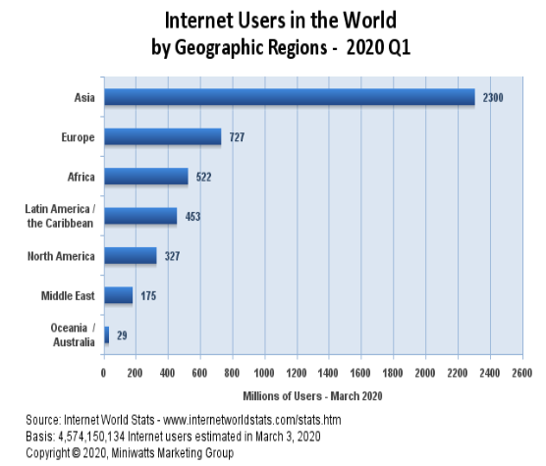
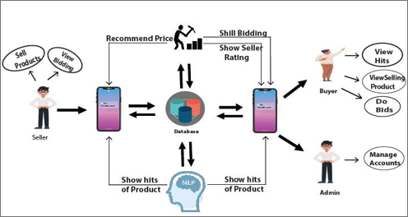
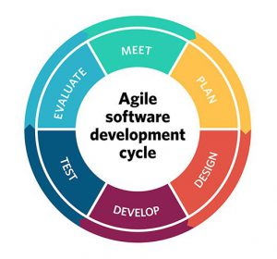
E-Commerce website
Online bidding system
Hassnain Nisar Asst. Prof. Dr. Vesile Evrim European University of Lefke, Engineering Faculty, Lefke, T.R.N.C
Introduction
Conclusions
Online Bidding System
World is moving toward and trying to achieve the Zero Second (Every work done by technology. And make it more fast and accurate.) Online Auction system held upon the internet. In Auction consumer served their time for bidding which kept effect of his daily’s routine life. Then online auction introduced after keeping eye on this problem. Many companies already working and providing this platform. This project helps to Consumers they can easily sell and buy the items according to their needs through bidding. This bidding system works under the AI algorithm technique. In this context people who use internet 80 percent of them are willing to buy and sell their products online will be effected. Our aim is to provide fair bidding online to facilitate people and more fair prices of their products.
Results
With the help of Online bidding system many people who are willing to sell and purchase the products online will be able to get the more reliable products in the reasonable price. This will also save the precious time of the people as world is moving toward the work done in zero second. This will help people to find the best and suitable products according to their need. Also with the help of Human phycological programming that will be our AL algorithm we will provide the more fair bidding and also block the fake bidding. This system will change and effect the life cycle of billions of people.
Internet Usage:
The usage of internet is rapidly increasing day by day. This is a computerized world. All things happening through internet include business and all kind of dealing.
According to the research 80 percent of the people who use internet are willing to sell and buy their products online
Through internet consumer are freely to bid consider without any disturbance in daily schedule. They can easily enter in auction during their office hour too.
According to the research world is going toward the online or digital payment. We decided to allow the customer to pay digitally. Here are some statistics.
In the eye of new world information is everything so the information of the users(Seller and Buyers) will be secure and also the statistics of the user selling and buying will help us to promote and make our system more user friendly.
These results shows that online bidding system is the need of time.
.
Online Bidding system will improve the online shopping system with the capability to handle the bidding and make it fair through the AI Algorithms.
It will directly effect the people who are willing to purchase and sell their products online and want to save their time.
Moreover, people who want to sell their products in reasonable price can get the real price of their products.
Since Internet is introduce every work is going to be digital to make fast processing of life without the wasting of time.
Online bidding or Smart Bidding system will also provide the security of the online payment with the help of 3rd party payment gateway APIs.
Methods & Materials
References
Agile software lifecycle:
We will use agile method to develop this software. Every phase will be implemented carefully and perfectly.
Bichler, Martin. (2000). "An experimental analysis of multi-attribute auctions“
Krishna, Vijay. (2002). Auction Theory. Burlington, MA: Academic Press.
Begard Aljaf December 2016 (ONLINE AUCTION SYSTEM)
This website is working on Auction based system which is totally under artificial intelligence. This website developing for the comfort and relief of the people.. This process consider according to safety and security. Because after successfully bidding the consumer personal account have personal detail of the user include his bank details as well. So this all will perform under the high-security platforms who keep their data safe from robbery and misuse. bidding will
Python will help to design AL Algorithms and Laravel will be used to design the website. Some other materials like Sql database and 3rd party APIs will also helpful to maintain our online bidding system.
Acknowledgements
start on the fixed schedule as Seller wants. Eventually, this will help people who wants to bidding can come and join in Auction. At the end of the bidding who will have the highest bid amount will be able to buy that item. And it will avoid shill bidding under the AI scanning technique. In Future if I update this website I will must update my AI for more relief and I have a plan this website will not perform bidding just about the item, it will consider as more about the sell and buy the land, house, and property on a commercial level. All will find on a single platform.
I would like to thanks my all honorable teachers and especially Supervisor Miss Vesile Evrim who supported me and plenty of encouragement, support
and guidance

